Slide 1
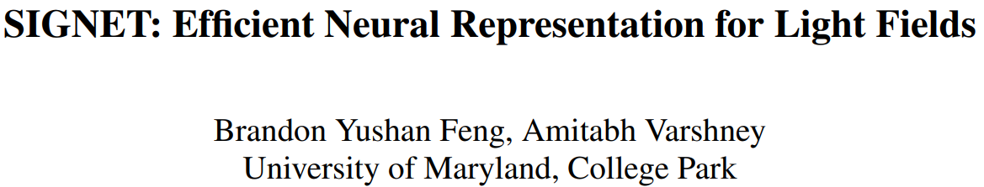

Slide 2
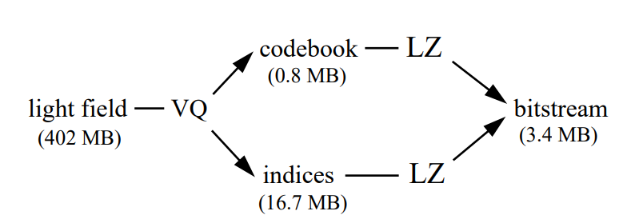
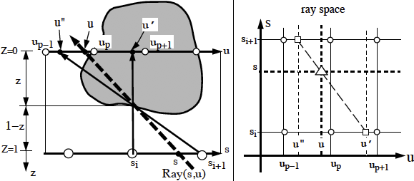
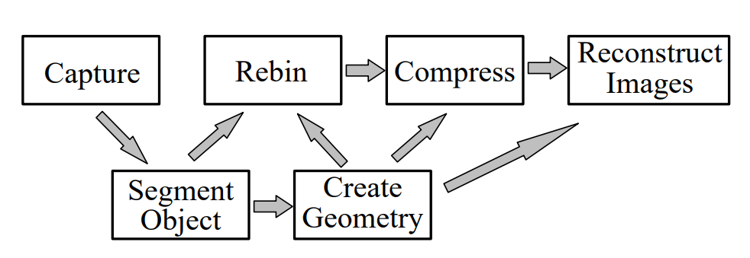
Problem
Not a compact representation
~ hundreds MB
Fixed resolution
Requires good geometric prior for high quality rendering

Slide 3

Idea of Neural Rendering
Novel View point synthesis:
Neural Network -> Encodes entire scene description, lighting, materials, etc.
6 DoF Camera Pose / View Point

Slide 4
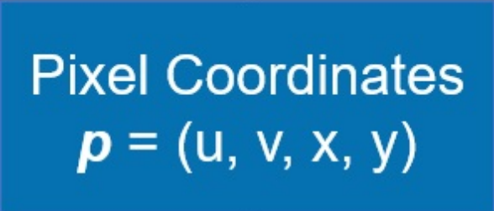
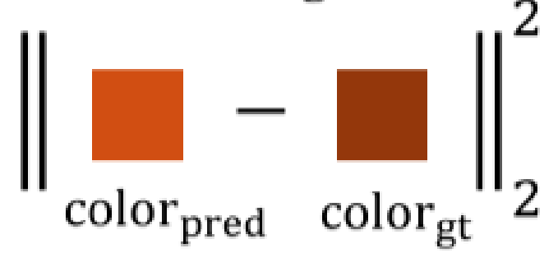
MLP representation
Positional encoding
Compression (~10MB)
Storage
Neural network as mapping function from coordinate to color
Evaluation (~40db)
Upsampling

Slide 5
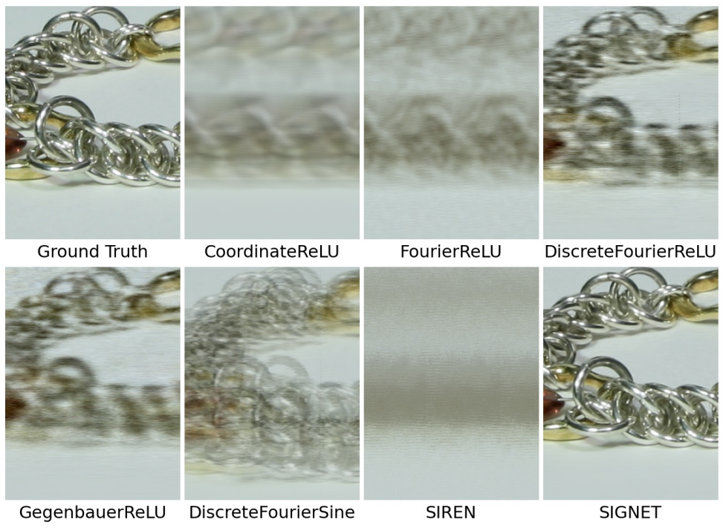
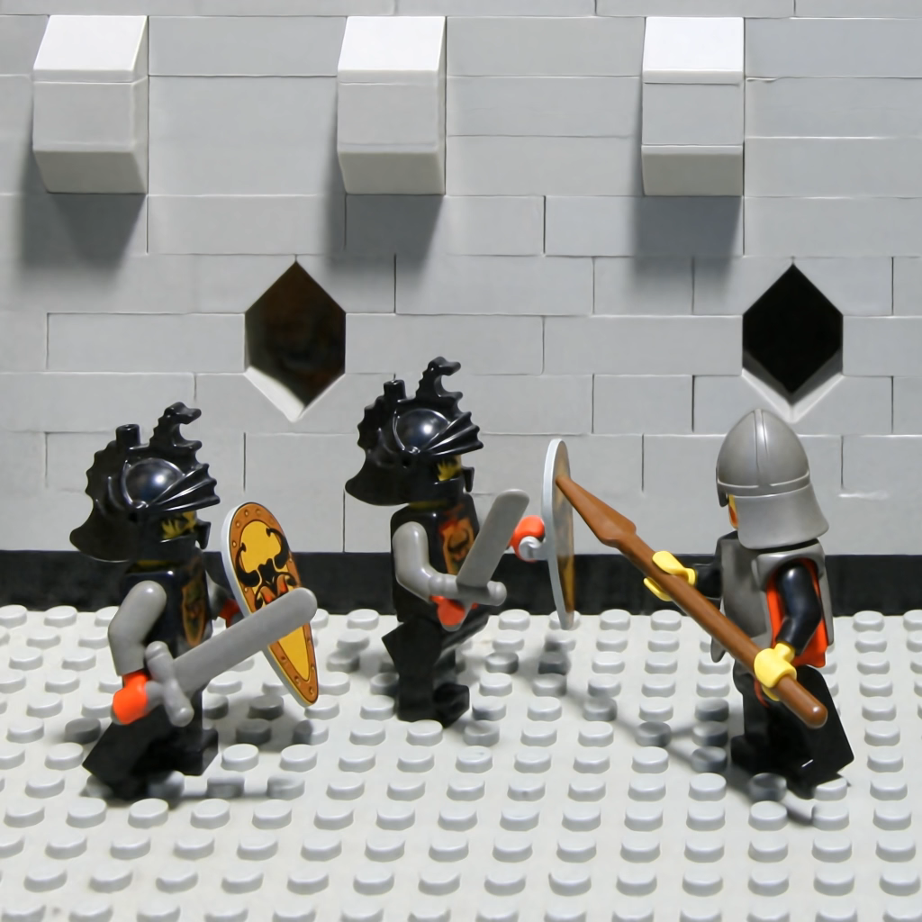

Positional Encoding
Fourier
Gegenbauer

Slide 6
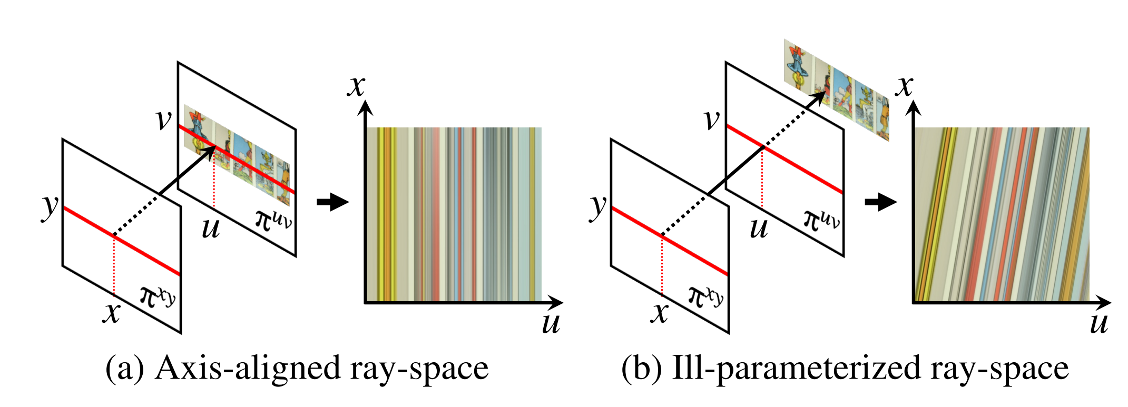
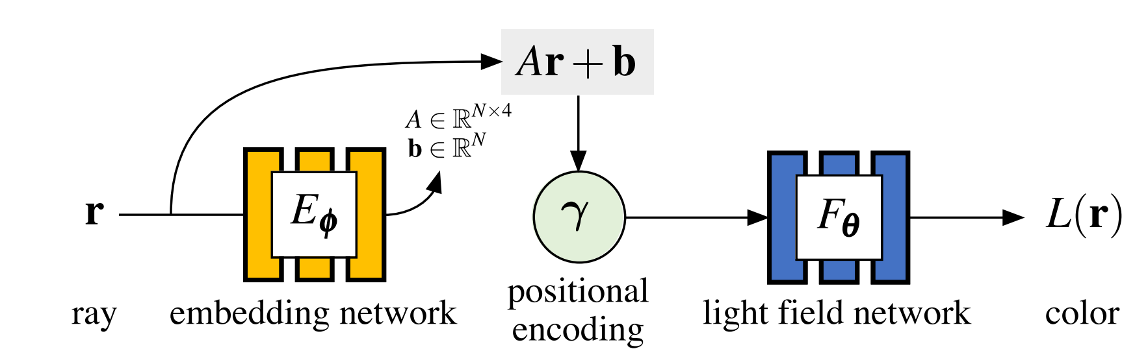
Learn an affine transformation
[1] B. Attal et al. Learning Neural Light Fields with Ray-Space Embedding Networks

Slide 7
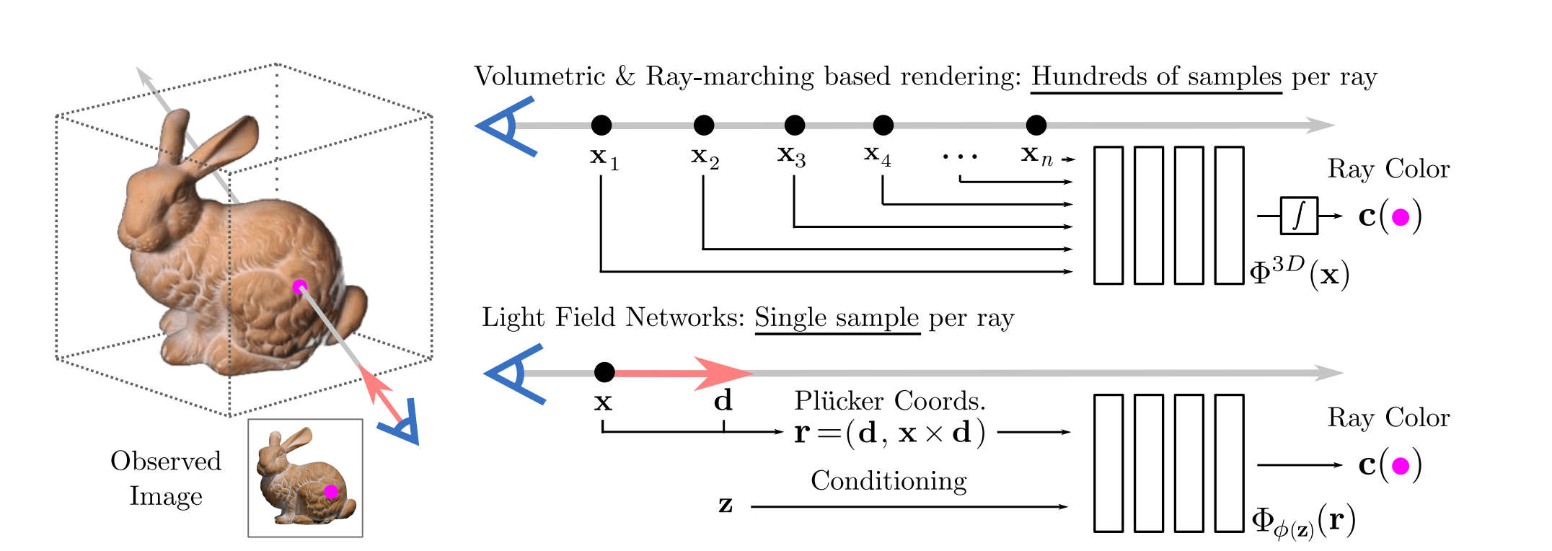
Light Field Network
[1] Light Field Networks: Neural Scene Representations with Single-Evaluation Rendering, NeurIPS 2021.

Slide 8
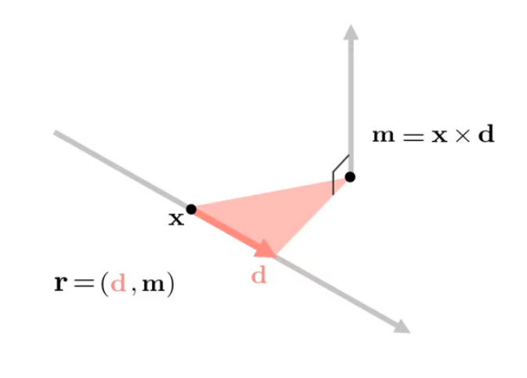
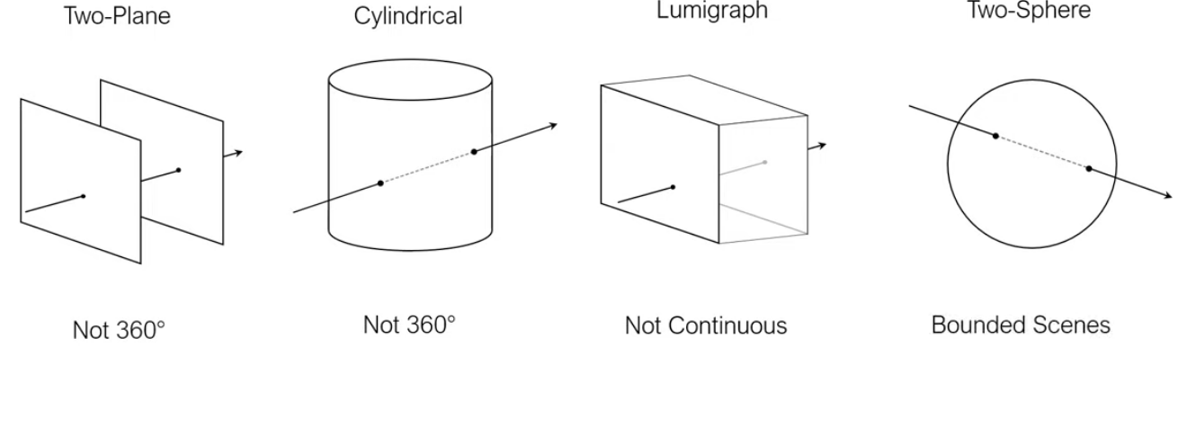
Plücker Coordinate

Slide 9
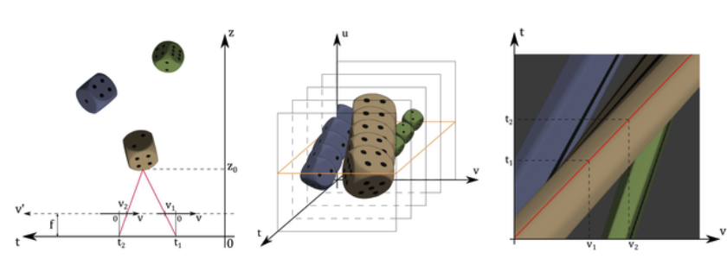
Epipolar plane image
t1, t2 is camera position
Fix u, yellow plane is epipolar plane image (EPI)
EPI

Slide 10
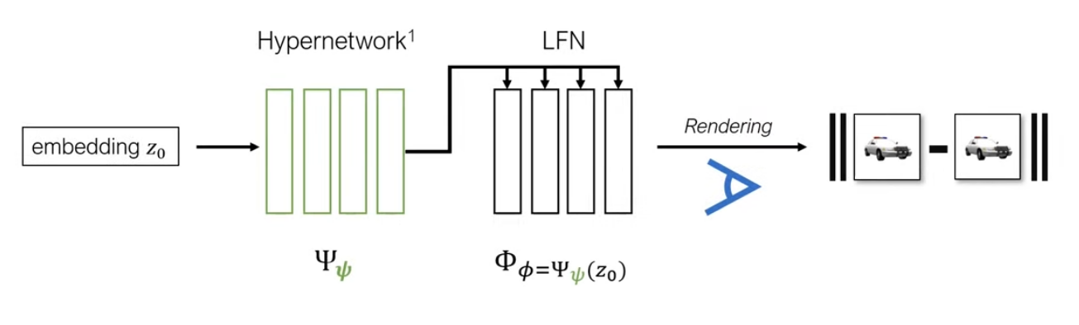
Meta-learning

Slide 11
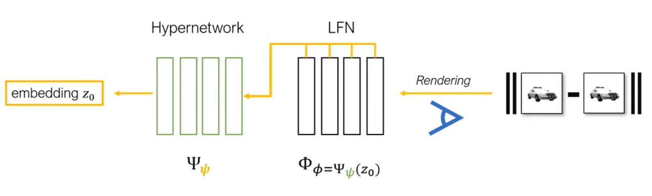
Meta-learning

Slide 12
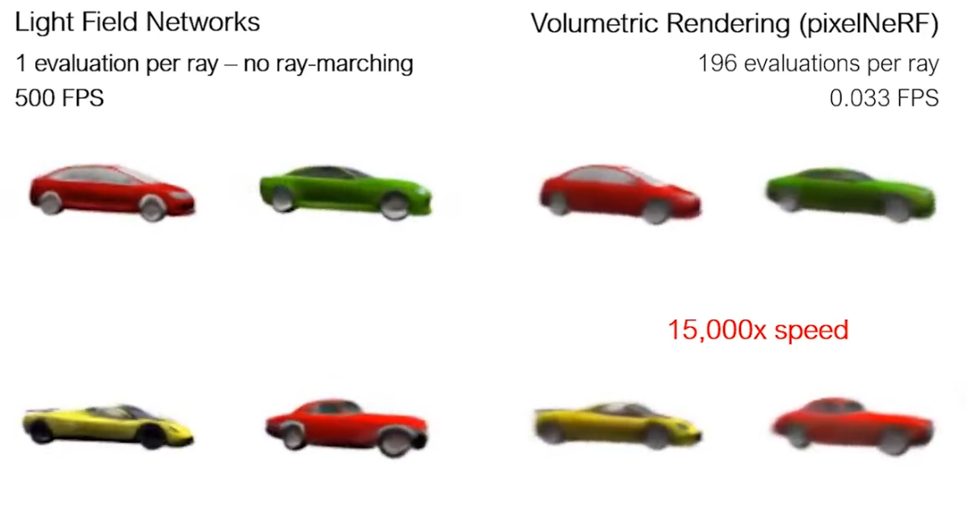
Meta-learning

